Slide 1
Discrete Math
CS 2800
Prof. Bart Selman
selman@cs.cornell.edu
Module
Basic Structures: Functions and Sequences

Slide 2
Functions
f(x)
Suppose we have:
x
How do you describe the yellow function?
What’s a function ?
f(x) = -(1/2)x – 1/2

Slide 3
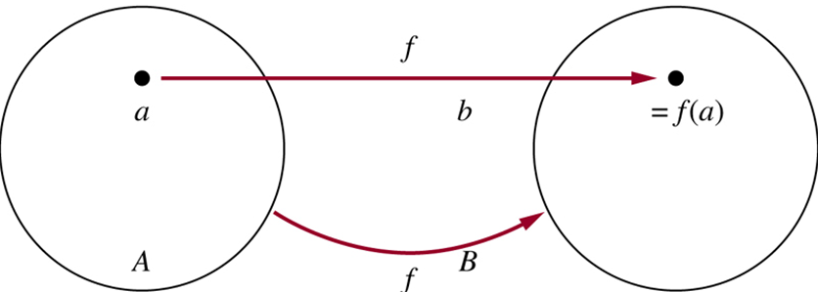
Functions
More generally:
B
Definition:
Given A and B, nonempty sets, a function f from A to B is an assignment
of exactly one element of B to each element of A. We write f(a)=b if b is
the element of B assigned by function f to the element a of A.
If f is a function from A to B, we write f : A→B.
Note: Functions are also called mappings or transformations.

Slide 4
Functions
A = {Michael, Toby , John , Chris , Brad }
B = { Kathy, Carla, Mary}
Let f: A → B be defined as f(a) = mother(a).
Michael Toby John Chris Brad
Kathy
Carol
Mary
B
A

Slide 5
Functions - image & preimage
image(S)
For any set S ⊆ A, image(S) = {b : ∃a ∈ S, f(a) = b}
So, image({Michael, Toby}) = {Kathy} image(A) = B - {Carol}
range of f
image(A)
Michael Toby John Chris Brad
Kathy
Carol
Mary
B
A
image(John) = {Kathy}
pre-image(Kathy) = {John, Toby, Michael}

Slide 6
Functions – one-to-one-correspondence or bijection
A function f: A → B is bijective if it is one-to-one and onto.
Every b ∈ B has exactly 1 preimage.
Anna Mark John Paul Sarah
Anna Mark John
Paul
Sarah
Carol
Jo
Martha
Dawn
Eve
Carol Jo Martha Dawn
Eve
An important implication of this characteristic:
The preimage (f⁻¹) is a function!
They are
invertible.

Slide 7
Infinite Cardinality
How can we extend the notion of cardinality to infinite sets?
Definition: Two sets A and B have the same cardinality if and only if there exists a bijection (or a one-to-one correspondence) between them, A ~ B.
We split infinite sets into two groups:
Sets with the same cardinality as the set of natural numbers
Sets with different cardinality as the set of natural numbers

Slide 8
Infinite Cardinality
Definition: A set is countable if it is finite or has the same cardinality as the set of positive integers.
Definition: A set is uncountable if it is not countable.
Definition: The cardinality of an infinite set S that is countable is denotes by א₀ (where א is aleph, the first letter of the Hebrew alphabet). We write |S| = א₀ and say that S has cardinality “aleph null”.
Note: Georg Cantor defined the notion of cardinality and was the first to realize that infinite sets can have
different cardinalities. א₀ is the cardinality of the natural numbers; the next larger cardinality is
aleph-one א₁, then, א₂ and so on.

Slide 9
Infinite Cardinality:
Odd Positive Integers
Example: The set of odd positive integers is a countable set.
Let’s define the function f, from Z⁺ to the set of odd positive numbers,
f(n) = 2 n -1
We have to show that f is both one-to-one and onto.
one-to-one
Suppose f(n)= f(m) → 2n-1 = 2m-1 → n=m
onto
Suppose that t is an odd positive integer. Then t is 1 less than an even integer 2k, where k is a natural number. hence t=2k-1= f(k).

Slide 10
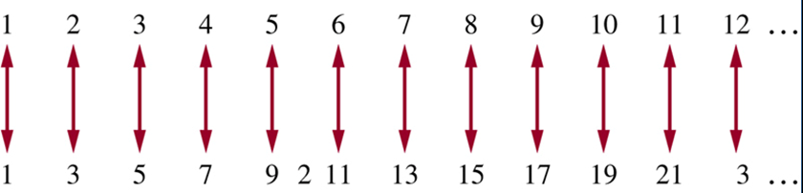
Infinite Cardinality:
Odd Positive Integers
2

Slide 11
Infinite Cardinality:
Integers
Example: The set of integers is a countable set.
Lets consider the sequence of all integers, starting with 0: 0,1,-1,2,-2,….
We can define this sequence as a function:
f(n) =
0
1
-1
2
2
Show at home that it’s one-to-one and onto

Slide 12
Infinite Cardinality:
Rational Numbers
Example: The set of positive rational numbers is a countable set. Hmm…

Slide 13
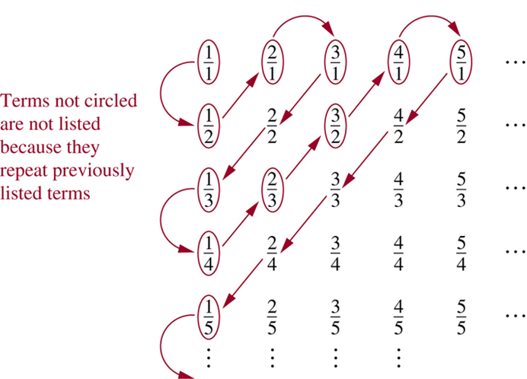
Infinite Cardinality:
Rational Numbers
Example: The set of positive rational numbers is a countable set
Key aspect to list the rational numbers as a sequence – every positive number is the quotient p/q of two positive integers.
Visualization of the proof.
p+q=2
p+q=3
p+q=4
p+q=5
p+q=6
Since all positive rational numbers are listed once, the set of positive rational numbers is countable.

Slide 14
Real Numbers: Uncountable
Example; The set of real numbers is an uncountable set.
Let’s assume that the set of real numbers is countable.
Therefore any subset of it is also countable, in particular the interval [0,1].
How many real numbers are in interval [0, 1]?

Slide 15
Real Numbers
How many real numbers are in interval [0, 1]?
“Countably many! There’s part of the list!”
0.4 3 2 9 0 1 3 2 9 8 4 2 0 3 9 …
0.8 2 5 9 9 1 3 2 7 2 5 8 9 2 5 …
0.9 2 5 3 9 1 5 9 7 4 5 0 6 2 1 …
…
“Are you sure they’re all there?”
Counterexample:
Use diagonalization
to create a new number
that differs in the ith
position of the
ith number
by 1.
0.5 3 6 …
So we say the reals are “uncountable.”

