Slide 1
CPI 360: Decision Making and Problem Solving
The following slides were downloaded from slideshare.net from ashish1afmi
Original slide numbers given. Add one to each to offset for this slide.
Table of Contents
1. What is PS & DM?: Slide 4
2. What does it involve? Skill, Tool, Process: Slide 11
3. Problem Solving Procedure: Slide 23
3.1 Define: Slide 24 3.2 Info measures (quantitative/qualitative): Slide 28 3.3 Analyze (data analysis, process analysis, tools): Slide 38 3.4 Generate alternatives (vertical and lateral thinking): Slide 62 3.5 Select alternatives/Decision Making: Slide 73 3.5.1 Environment: slide 78 3.5.2 DM models (classical, behavioral): Slide 81 3.5.3 DM realities: slide 87 3.5.4 Authorities in DM: slide 91 3.5.5 Influencing factors: slide 94 3.5.6 6Cs: Slide 104 3.5.7 Traps: Slide 107 3.5.8 Financial tools for evaluation: Slide 109 3.6 Decide and implement: Slide 111 4. Complex problem solving: Slide 113

Slide 2
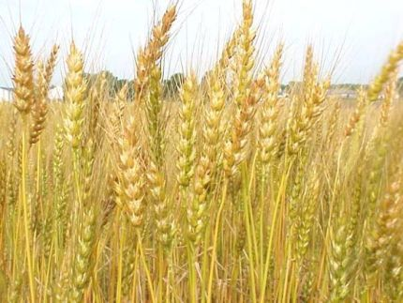

DECISION MAKING AND PROBLEM SOLVING
Session – 1

Slide 3
Scope of Discussion
To Clarify and Define the Problem.
To understand the benefit of collective problem solving and decision making.
To examine decision making models.
Application of Creativity in Problem Solving/Decision Making process.
To Plan, Practice, and To solve Problem with making decisions through case studies, role playing and group discussions.

Slide 4

What is Problem Solving & Decision Making?
Activity - 1
Write One Sentence Definition of Problem Solving & Decision Making

Slide 5

DEFINITION – Problem Solving
A systematic approach to defining the problem and creating a vast number of possible solutions without judging these solutions.
Problem solving is a Cognitive Processing directed at achieving a goal where no solution method is obvious to the problem solver.

Slide 6

Is this Problem Solving???
Problem Solving is ….
“….the art of finding the ways to get from where you are now to where you want to be (assuming you do not already know how).
The ‘Problem’, therefore, is a the gap between the present situation and a more desirable one.”
Nolan
A B

Slide 7
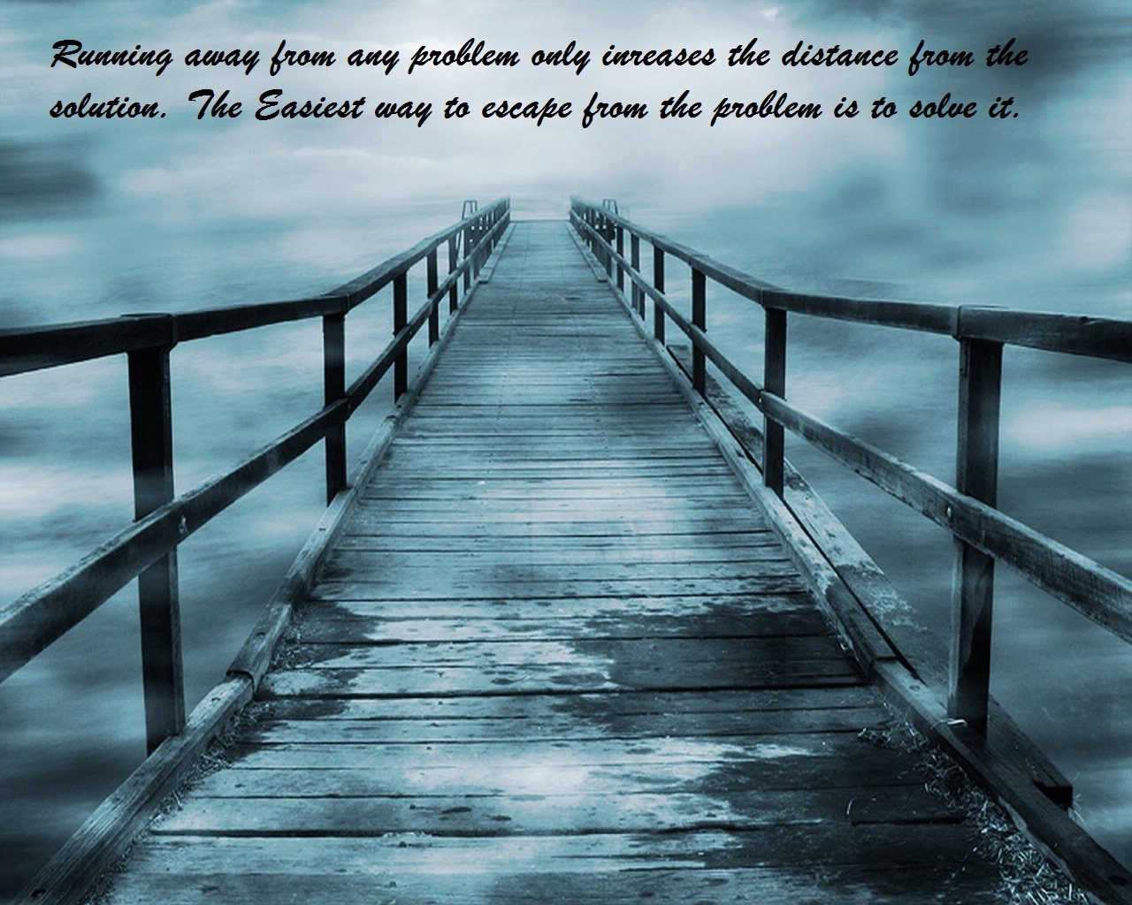

Slide 8
Triple Constraint Principle
Time
Cost
Problem
Performance
Something is a problem if:
It makes you LATE
It increases COST
It degrades PERFORMANCE

Slide 9


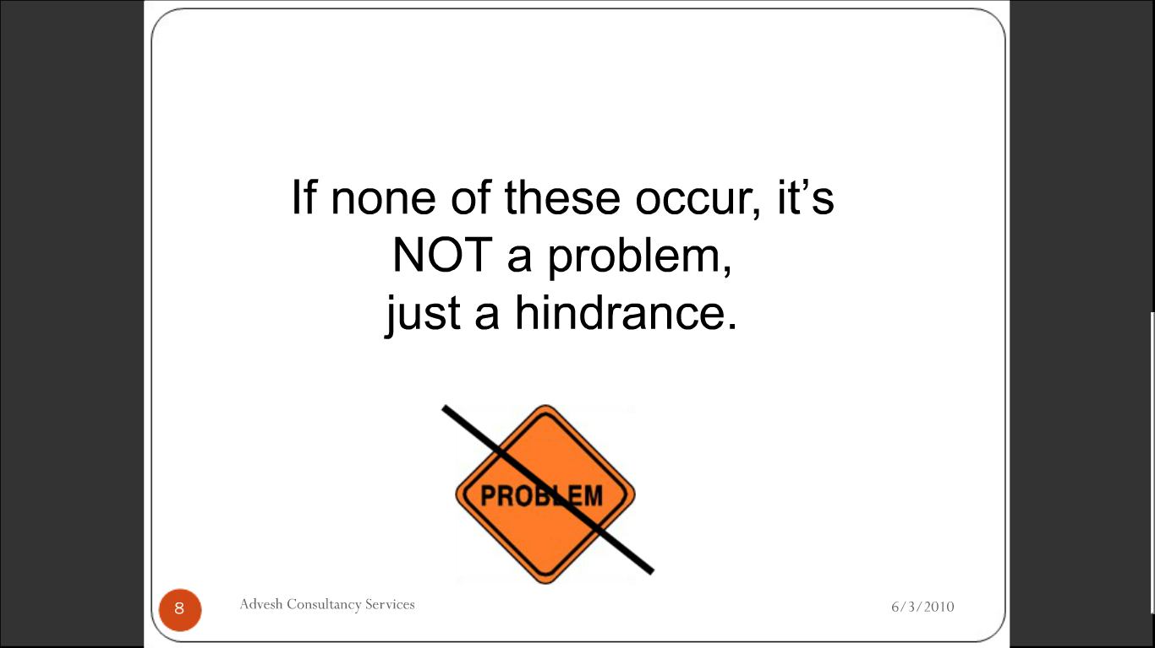

Activity - 2
If none of these constraint occur then WHAT is it
CALLED?

Slide 10


DEFINITION – Decision Making
The act of narrowing down the possibilities, choosing a course of action and determining the action’s potential consequences.
“Its not a Problem that we have a Problem. It’s a Problem if we don’t deal with the Problem.”
Mary Kay Utech

Slide 11
What does it Involve??
Problem Solving is a Skill, a Tool and a Process.
It is a Skill because once you have learnt it you can use it repeatedly.
Like the ability to ride a bicycle, or
Add numbers or
Speak a language.
It is a Tool because it can help you solve an immediate problem or to achieve a goal.
It is also a Process because it involves taking a number of steps

Slide 12

PROBLEM SOLVING
Skill
Process
Tools

Slide 13

Skill Sets in Problem Solving?
Making Judgment
Analytical Skills
Decision Making
Collecting Information
Planning

Slide 14

Problem Solving People
Expert Problem Solvers
SMAs (Subject Matter Analysts)
People who can think of alternatives even when no
clear solutions seems apparent.

Slide 15

Expert Problem Solvers
Have a Better Memory for relevant details in the problem.
Classify problems according to their underlying principles.
Use well-established Procedures.
Work forwards towards a goal.

Slide 16
Problem Solving Requirements
Content Understanding
Domain-Dependent
Problem-Solving
Strategies
Self-Regulation
Meta cognition
Effort
Motivation
Planning
Self-Monitoring
Self-Efficacy

Slide 17
Understanding the Process
Focus: I want to and I can
“How to Solve it”
Read the problem (And all the Information)
Listen
Learn about the situation that poses the problem.
Motivation
Overcome Panic

Slide 18
Understanding the Process
Understand the problem: Define
“Put in the time to define the
problem”
Discuss.
Ask Questions.
Visualize.
Restate the problem in your own words.
Explain the problem to someone else.

Slide 19
Understanding the Process
Plan a procedure to solve the problem:
Prior Experience
Data Available.
Content Knowledge.
Patterns
Estimation & Alternate Solution.
Feasibility.

Slide 20

Understanding the Process
Collect data & the knowledge required
“A solution may be required based
upon imperfect knowledge”

Slide 21

Understanding the Process
Select the preferred solution: Test, Use & Evaluate
Check each Step
Determine clearly that each step is correct.
Can you prove that each step is correct.

Slide 22

Understanding the Process
Reflect on the Process
Are you certain of problem being solved?
Can you check the result and your argument?
Can use alternate solutions?
What did you actually do?
Can you explain this to another?
Can you use the result &/or method for
another problem?

Slide 23
PROBLEM SOLVING PROCEDURE
Define
Information Measures
Analyze
Generate Alternatives
Select Alternatives
Decide & Implement

Slide 24

STEP 1
DEFINE

Slide 25

DEFINING THE PROBLEM
Collect all the relevant information.
Clarify background issues.
What are the constraints?
Are there sub-problems that can be dealt with separately?
Can the problem now be formulated?

Slide 26
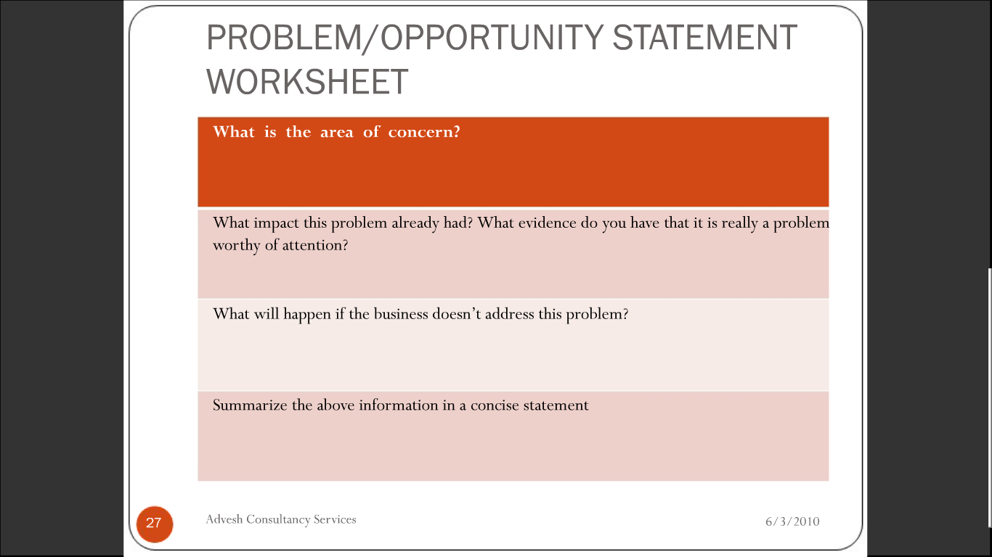
PROBLEM/OPPORTUNITY STATEMENT WORKSHEET

Slide 27
Activity - 2
Problem 1
I am in the habit of coming late to Work.
Problem 2
We could not meet production targets.
Problem 3
Take an issue in work situation, Define the problem?

Slide 28

STEP 2
INFORMATION &
MEASURES

Slide 29
Activity – 2A
Imagine that you were going to buy a house in a new area. List 10 things that you would want to know about a house before you gave it serious consideration.

Slide 30

TYPES OF INFORMATION
QUANTITATIVE
QUALITATIVE

Slide 31
TYPES OF INFORMATION
QUANTITATIVE
QUALITATIVE
How Much?
How Many?
How Frequently?
How Likely?
How Quickly?
What ?
Why?
How?

Slide 32


DATA SOURCES
PRIMARY
SECONDARY

Slide 33
DATA SOURCES
PRIMARY
SECONDARY
Data gathered by you directly for your purpose.
Research.
Survey
Gathered by others for their purpose.
By other Depts.
Reference Books
Databases.
Journals.
Published Reports.
Govt. Statistics

Slide 34
Activity – 3A
In a production line, the output of a particular machine has come down drastically. There was a hue and cry that the operator is intentionally slowing down prod..
What all information need to be collected before commencing any action?

Slide 35
Activity – 3B
First batch of vacuum Circuit Breakers supplied by a Company in India in the year 1981 failed miserably.
The Technical collaborators, the Manufacturers and the Customers were trying to resolve the issue
What all information need to be collected before commencing any action?

Slide 36
Activity – 3C
On apiece of paper, draw a map of the people you know. Put yourself in the middle and connect the people you know very well in the first circle. Add people you know through these network in the next layer and connect them with spokes.
Do this 3 levels.

Slide 37
DECISION MAKING AND PROBLEM SOLVING
Session – 2

Slide 38


STEP 3
ANALYSE
Problem
Seen
Un Seen

Slide 39

ANALYSE THE PROBLEM
Do not make the mistake of assuming you know what is causing the problem without an effort to fully investigate the problem you have defined. Try to view the problem from a variety of viewpoints, not just how it effects you. Think about how the issue affects others. It is essential to spend some time researching the problem.

Slide 40

QUESTIONS TO ASK WHEN ANALYSING THE PROBLEM
What is the history of the problem? How long has it existed?
How serious is the problem?
What are the causes of the problem?
What are the effects of the problem?
What are the symptoms of the problem?
What methods does the group already have for dealing with the problem?
What are the limitations of the those methods?
How much freedom does the group have in gathering information and attempting to solve the problem?
What obstacles keep the group from achieving the goal?
Can the problem be divided into sub problems?

Slide 41

MAKING SENSE OF NUMBERS
Averages ( Mean, Median, Mode).
Grouping of Data.
Probability Distribution (Normal, Poisson etc).
Trends (Moving Average, Weighted Average etc).
Correlation (Simple, Table, Bowles & Karl Pearson’s).
Pie Charts.

Slide 42
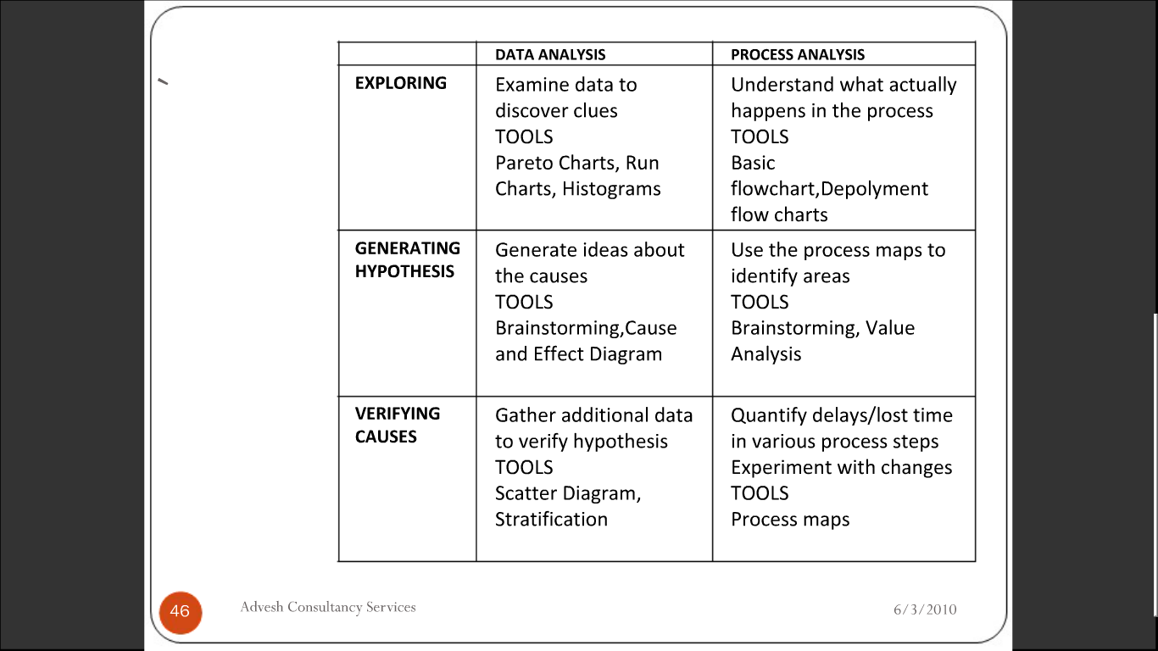
DATA ANALYSIS V/s PROCESS ANALYSIS

Slide 43
CAUSE AND EFFECT DIAGRAM
Session – 3

Slide 44
FISHBONE DIAGRAM
When should a fishbone diagram be used?
Need to study a problem/issue to determine the root cause?
Want to study all the possible reasons why a process is beginning to have difficulties, problems or breakdown?
Need to identify areas for data collection?
Want to study why a process is not performing properly or producing the desired results?

Slide 45
HOW TO CONSTRUCT A FISHBONE DIAGRAM ?
Draw the Fishbone diagram……..
List the problem/Issue to be studied in the “Head of the Fish”.
Label each “Bone” of the “Fish”. The major categories typically utilized are:
The 4 M’s:
Methods, Machines, Materials & Manpower.
The 4 P’s:
Place, Procedure, People & Policies.
The 4 S’s:
Surroundings, Suppliers, Systems & Skills.
Note: You may use one of the 4 categories suggested, combine them in any fashion or make up your own. The categories are to help you to organize your ideas.

Slide 46

THE 5 W’s?

Slide 47
HOW TO COMPLETE THE 5 WHYs?
Write down the specific problem. Writing the issue helps you to formulize the problem and describe it completely. It also helps a team focus on the same problem.
Ask Why the problem occurs? And write the answer down below the problem.
If the answer you just provided doesn’t identify the root cause of the problem that you wrote down in step 1, ask Why again and write that answer down.
Loop back to Step 3 until the team is in agreement that the problem’s root cause is identified. Again, this may take few or more times than 5 Whys

Slide 48
Activity – 4
Customers are unhappy because they are being shipped products that don’t meet their specifications.
How to apply 5 Whys for the above problem statement?

Slide 49
THE 5 WHYs with Solution
Why are customers being shipped bad products?
Because manufacturer built the products to a specification that is different from what the customer and the sales person agreed to.
Why did manufacturer built the products to a different specification than that of sales?
Because the sales person expedites work on the shop floor by calling the head of manufacturing directly to being work. An error happened when the specifications were being communicated or written down

Slide 50
THE 5 WHYs with Solution
Why does the sales person call the head of manufacturing directly to start work, instead of following the Protocol established in the company?
Because the “Work Order” form requires the sales directors’ approval before work can begin and slows the manufacturing process (or stops it when the director is out of the office).
Why does the form contain an approval for the sales director?
Because the sales Director needs to be continually updated on sales for discussions with the CEO.

Slide 51
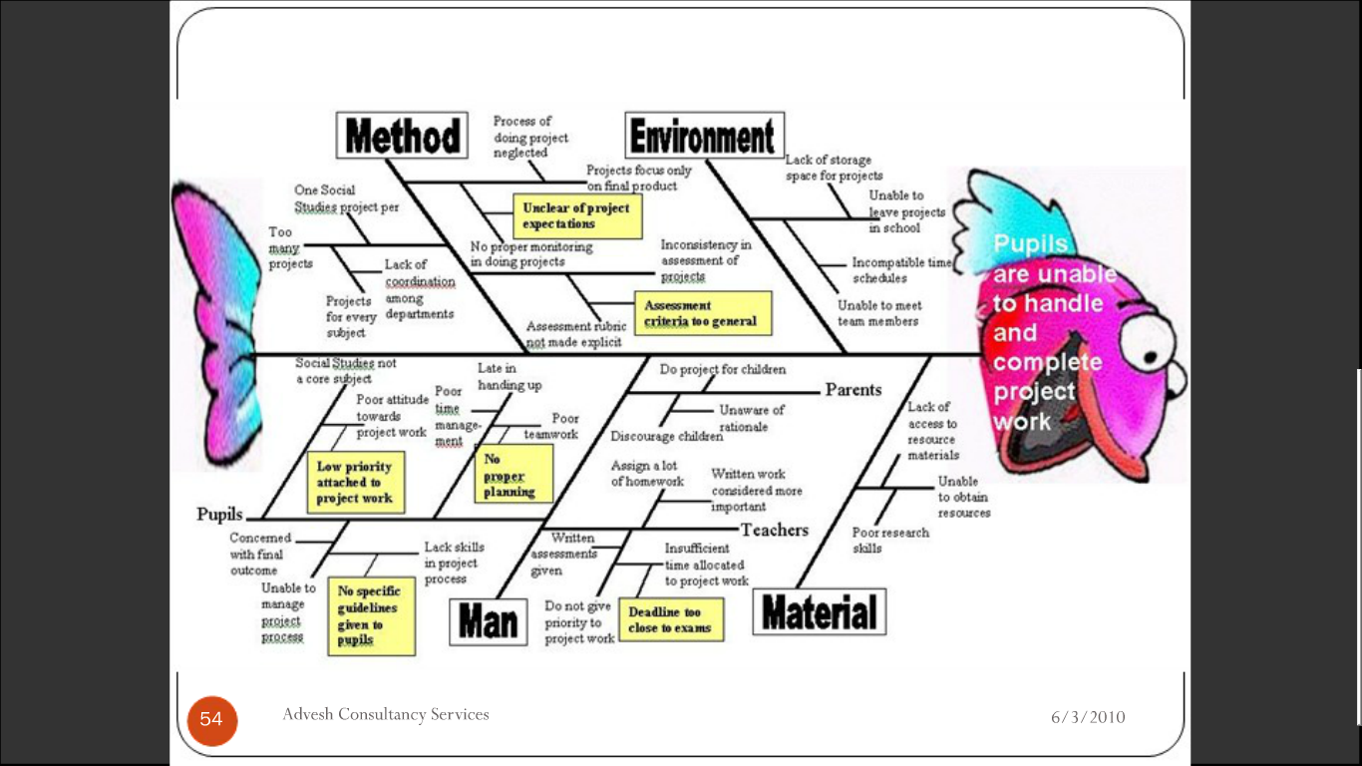

Slide 52
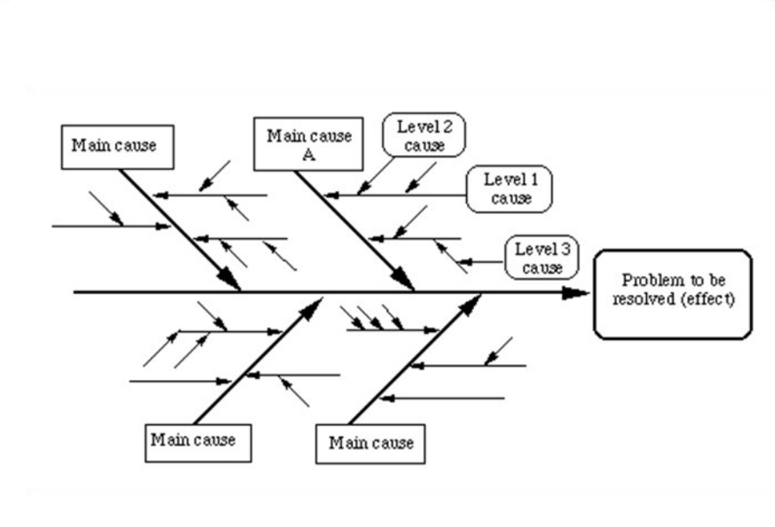

Slide 53
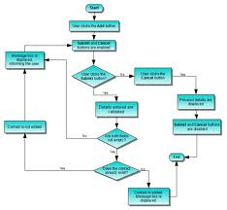
TYPES OF FLOW CHARTS
Linear Flowchart
Deployment Flowchart
Opportunity Flowchart

Slide 54

VERIFYING CAUSES
Correlation
Stratification
Pilot Testing

Slide 55
LINEAR FLOWCHAT
Collect Inputs
Start
Draft Circular
Type Rough
Submit to A
Retype
Stop
OK
Final Draft
Signature (A)
Make Copies
Distribute

Slide 56
DEPLOYMENT FLOWCHAT
Collect Information
Type Rough
Submit to C
Accept?
Draft
Retype
Activity – 5
Final Draft
Signature
Draw a Deployment flow chart using the details given:
Make Copies
Distribute

Slide 57
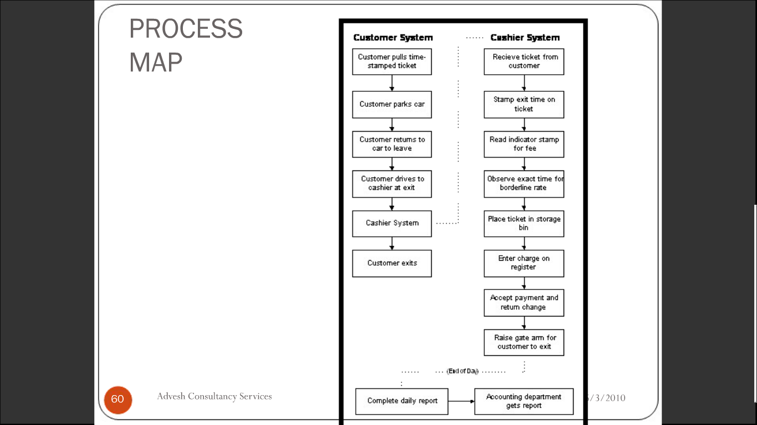
PROCESS FLOWCHAT

Slide 58
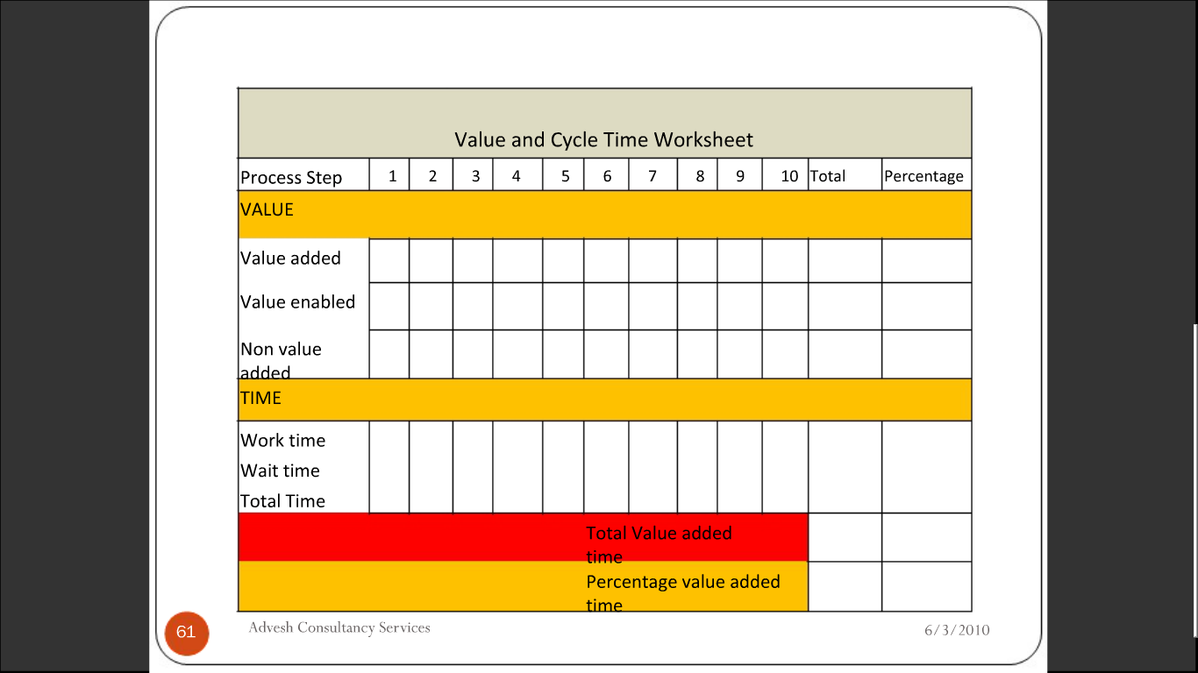

Slide 59
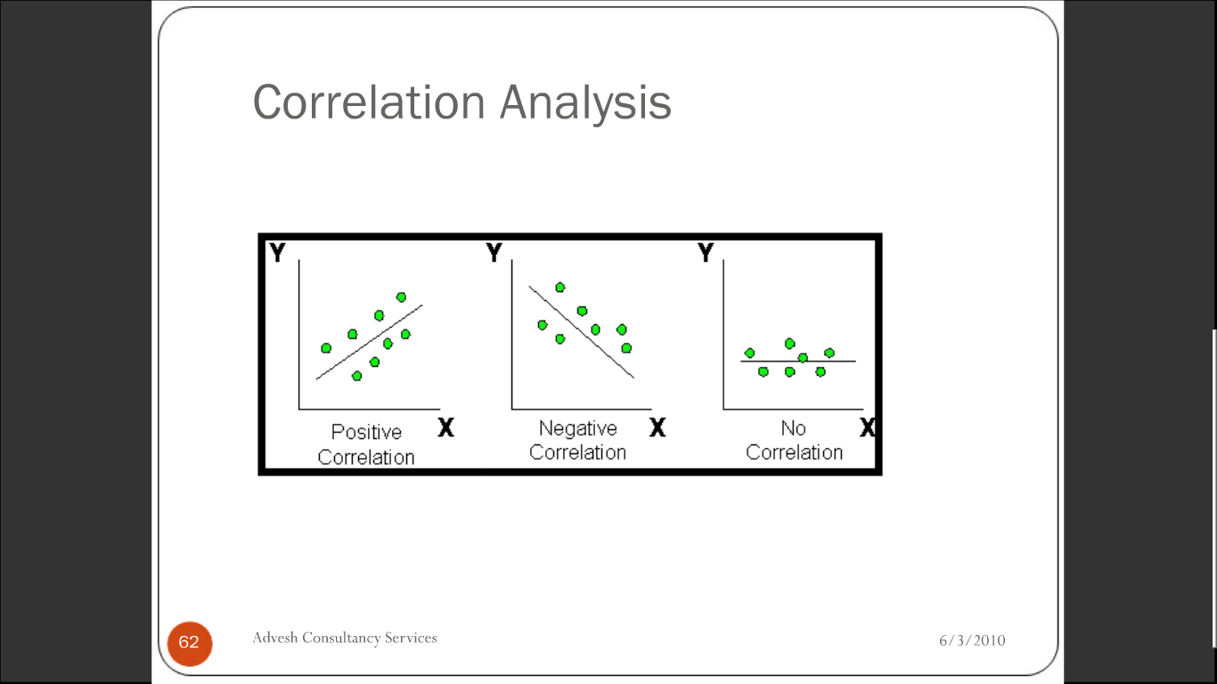
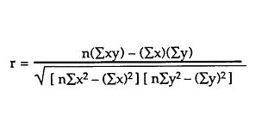
CORRELATION ANALYSIS

Slide 60
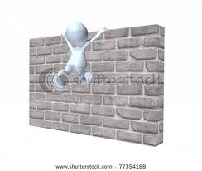
PAST EXPERIENCE: FUTURE PROBLEMS
Have you encountered a problem like this before?
Do you have all of the information and data which is required?
Is there any pattern to what you know?
Can you construct a table or a picture?
What might be the solution?
What would assist us in getting to a solution?
Problem

Slide 61

CLASS
FOR 15 MINUTES

Slide 62

STEP 4
GENERATE
ALTERNATIVES

Slide 63

TIPS FOR GENERATING ALTERNATIVES
Brainstorming.
Involve Outsiders.
External Benchmarking
Encourage members to step out of their traditional roles.
Ask probing questions.
Be willing to consider views differing from yours.
Revisit abandoned alternatives.

Slide 64


WHAT IS VERTICAL THINKING??
Basing our thought process on prior knowledge and experience.
Using logic that relates only to our
immediate experience.
Constraining our creativity and ability to solve problems.

Slide 65

WHAT IS LATERAL THINKING??
Changing Orientation and perception.
Generating New Ideas and Visions.
Exploring multiple possibilities and approaches.

Slide 66
OBSERVATION B/W LATERAL & VERTICAL THINKING
Vertical Thinking is selective.
One may reach a conclusion by a valid series of steps.
Lateral Thinking is generative.
Vertical thinking develops the ideas generated by lateral thinking.

Slide 67
Activity – 6
How would you divide a square into four equal pieces.
Give at least 6 alternatives?

Slide 68
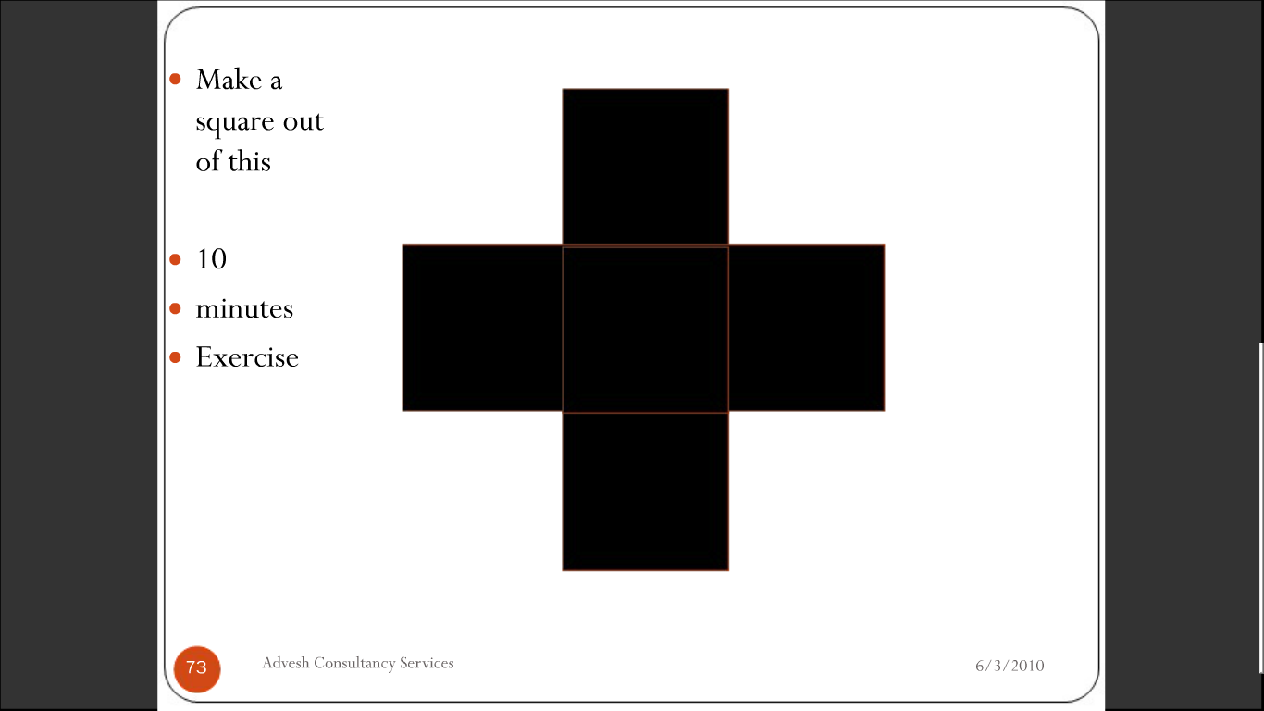
05 Minutes
Make a Square out of this??

Slide 69
Activity – 6A
The DOG, The GOOSE, and The BAG of CORN
A poor farmer is going to market with his old and very hungry dog, a plump goose to sell, and a bog of corn. The farmer knows that unless he is right there, either the dog will eat the goose or the goose will eat the corn. He is almost to market when he reaches a small stream, which he must cross. There is a small boat there but it can only carry the poor farmer plus one more thing. How can he get the dog, the goose, and the bag of corn to market safely, uneaten?

Slide 70
The DOG, The GOOSE, and The BAG of CORN
The farmer takes the goose across and leaves the dog with the corn.
The farmer then goes back across the stream and gets the corn.
He takes the goose back across with him because he cannot leave it with the corn.
He then gets the dog and takes it across leaving it on the other side with the corn.
He then goes back across once again, gets the goose and returns to the other side of the stream with all safely across and not eaten!!

Slide 71
Activity – 6B
You have a pile of 24 coins. 23 of them have the same weight. But one of them is heavier than the rest. You are given a scale but no weights. Your task is to identify the heavy coin in not more than 3 uses of the scale.

Slide 72
Activity – 6C
4 men, one of whom was known to have committed murder, made the following statements to the police.
Arun: Dave did it.
Dave: Toney did it.
George: I did not do it.
Toney: Dave lied when he said I did it.
If one of these 4 statements is true, who was the guilty man?

Slide 73
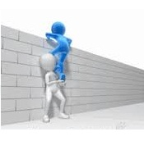
STEP 5
SELECT
ALTERNATIVES/
DECISION MAKING

Slide 74

TYPES
Strategic Decision.
Business Decision.
Operational Decision

Slide 75
Activity – 7
List 3 personal decisions you’ve made in the last one or 2 years.
List 3 decisions you need to take in the next 1 year in your personal life.
Classify them into Strategic, Business & Operational.

Slide 76

How are decisions made in Organizations?
Decision making:
The process of choosing a course of action for dealing with a problem or opportunity.

Slide 77
DECISION MAKING
Environment
Decision Making Models
Decision Making Realities
Authorities in Decision Making
Influencing Factors in Decision Making
7Cs

Slide 78
How are decisions made in Organizations?
Decision Environments Include:
Certain environment
Exist when information is sufficient to predict the results of each alternative in advance of implementation.
Certainty is the ideal problem solving and decision making environment
Risk environment
Exist when decision maker lack complete certainty regarding the outcome of various courses of action, but can assign probabilities of occurrence.
Probabilities can be assigned through objective statistical procedures or personal institution.

Slide 79
How are decisions made in Organizations?
Decision Environments Include:
Uncertain environment
Exist when managers have so little information that they cannot even assign probabilities to various alternatives and possible outcomes.
Uncertainty forces decision makers to rely on individual and group creativity to success over the problem.
Also characterized by rapidly changing :
External Conditions
IT requirements
Personnel Influencing problem and choice definition.
These rapid changes are also called organized anarchy.

Slide 80
DECISION MAKING MODELS
Session – 4

Slide 81
DECISION THEORY
Classical Decision Theory.
Behavioral Decision Theory.

Slide 82
What are the useful decision making models?
Classical Decision Theory:
Views the decision maker as acting in a world of complete certainty.
Behavioral Decision Theory:
Accepts a world with bounded rationality and views the decision maker as acting only in terms of what he/she perceives about a given situation

Slide 83
The Classical Decision Making Models?
Classical Decision Theory:
The Classical Decision Maker:
Faces a clearly defined problem.
Knows all possible action alternatives and their consequences.
Chooses the optimum alternative.
It is often used as a model of how Managers should make decisions:

Slide 84
The Behavioral Decision Making Models?
Behavioral Decision Theory:
Recognizes that human beings operate with:
Cognitive Limitations.
Bounded Rationality.
The Behavioral Decision maker:
Faces a problem that is not clearly defined.
Has limited knowledge of possible action alternatives and their consequences.
Chooses a satisfactory alternative.

Slide 85
What are the useful decision making models?
Classical Decision Theory:
May not fit well in a chaotic world.
Can be used towards the bottom of many firms, even most high-tech firms.
Behavioral Decision Theory:
Fits with a chaotic world of uncertain conditions and limited information.
Encourages satisfying decision making.

Slide 86
DECISION MAKING REALITIES
Session – 5

Slide 87
Decision Making Realities
Most decision making in organizations goes beyond step-by-step rational choice.
Most decision making in organizations falls some where between the highly rational and the highly chaotic.
Decisions must be made under risk & uncertainty.
Decisions must be made to solve non-routine problems.
Decisions must be made under time pressures and information limitations.
Decisions should be ethical.

Slide 88
Intuition, Judgment & Creativity affect Decision Making
Intuition:
The ability to know or recognize quickly and readily the possibilities of a given situation.
A key element of decision making under risk and uncertainty.
Judgment:
Simplifying strategies or “Rule of Thumb” used to make decisions.
Makes it easier to deal with uncertainty and limited information.
Can lead to systematic, error free and quality decisions.

Slide 89
Activity – 8
Imagine that you are driving across country to an important meeting that will start in an hour’s time, along a route you have travelled several times before. You are thirty miles from your destination and the road is clear ahead of you. You see a signpost pointing up to a narrow side road that you have not noticed on earlier journeys. It indicates 20 miles to your destination.

Slide 90
Activity – 8
Would you turn into the side road without further thoughts?
Ignore the side road and continue on your existing route?
Stop the vehicle, refer to a map and then decide whether to drive up the side road? Why?

Slide 91
Authority in Decision Making
Deciding who should participate:
Authority Decisions
Made by the Manager or TL without involving other people and by using information that he / she possess.
Consultative Decisions.
Made by one individual after seeking input from group members.
Group Decisions
Made by all members of the group.

Slide 92
Activity – 8A
Give 3 examples of decisions that you would refer to a senior manager in your organization.
Do these decisions have anything in common?

Slide 93
INFLUENCING FACTORS DECISION MAKING.
Session – 6

Slide 94

What factors do influence Decision Making Process?
Technology.
Culture.
Ethics.

Slide 95
How do Tech., Culture & Ethics influence Decision Making?
Increasingly complex problems and opportunities face decision makers in organizations due to various workplace trends.
These workplace trends are changing the Who, When, Where, and How of decision making.
IT and Decision Making
Artificial Intelligence:
The study of how computers can be programmed to think like human beings.
Will allow computers to displace many decision makers.
Expert systems that support decision making by following “Either – or” rules to make deductions.

Slide 96
How do Tech., Culture & Ethics influence Decision Making?
Fuzzy Logic and Neural Networks.
Computer support for decision making:
The Internet
The Intranet
Decision support software.
Virtual Team work.

Slide 97

Assignment – 1
What is Fuzzy logic? Explain the working mechanism of Fuzzy logic with an example of your choice.
What is Neural Networking? Where do you find its application in the industry? Provide an example?

Slide 98
How do Tech., Culture & Ethics influence Decision Making?
Cultural Factors and Decision Making
Culture is “The way in which a group of people solves problem”.
North American culture stresses decisiveness, speed, and the individual selection of alternatives.
Other cultures pay less emphasis on individual choice than on developing implementations to solve the problems.
The most important impact of culture on decision making concerns are with issues related to the status problems in the firm.

Slide 99
How do Tech., Culture & Ethics influence Decision Making?
Ethical Issues and Decision Making
Ethical Dilemma.
A situation in which a person must decide whether or not to do something that, although personally or organizationally beneficial, may be considered unethical and perhaps illegal.
Ethical dilemmas are often associated with:
Risk and Uncertainty.
Non routine Problem Situations.

Slide 100
How do Tech., Culture & Ethics influence Decision Making?
Ethical Decision Making Checklist:
Is my Action Legal?
Is it Right?
Is it Beneficial?
How would I feel if my Family found out about this?
How would I feel If my Decision were printed in the local newspapers?

Slide 101
How do Tech., Culture & Ethics influence Decision Making?
Suggestions for integrating ethical decision making into the firm.
Develop a code of ethics and follow it.
Establish procedures for reporting violations.
Involve employees in identifying ethical issues.
Monitor ethical performance.
Reward ethical behavior.
Publicizing ethical efforts.

Slide 102
How do Tech., Culture & Ethics influence Decision Making?
Implications of ethics for decision making.
Morality is involved in:
Choosing problems.
Deciding who should be involved in making decisions.
Estimating the impacts of decision alternatives.
Selecting an alternative for implementation.
Moral conduct does not arise from after-the-fact embarrassment.

Slide 103
Activity – 9
One of the best performing employees under you was caught carrying one stapler belonging to the company at the gate..

Slide 104

Six C’s of Decision Making
Construct.
Compile.
Collect.
Compare.
Consider.
Commit.

Slide 105
Six C’s of Decision Making
Construct a clear picture of precisely what must be decided.
Compile a list of requirements that must be met.
Collect information on
alternatives that meet the
requirements.

Slide 106
Six C’s of Decision Making
Compare alternatives that meet the requirements.
Consider the “What might go wrong” factor with each alternative.
Commit to a decision and stick
to it.

Slide 107

Inherent System: Traps
Trying too hard to play it safe.
Letting fears and biases, tilt your thinking and analysis.
Getting lost in the minute aspects.
Craving unanimous approval.
Trying to make decisions which are outside your realm of authority.

Slide 108
Inherent System: Traps
Willing to begin with too little, inaccurate, or wrong information.
Overlooking viable alternatives or wasting time considering alternatives which have no realistic prospects.
Not following the 6 C’s.
Failing to clearly define the results you expect to achieve.
Worst of all, failing to reach a decision.

Slide 109
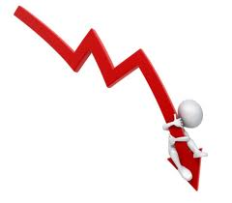



Financial Tools For Evaluating Alternatives
ROI
Pay Back
NPV (Net Present Value)
IRR (Internal Rate of Return)
BEA (Break Even Analysis)
SA (Sensitivity Analysis)

Slide 110
Activity – 10
List 4 or 5 decisions you made at work / home regardless of their size or importance. For each decision, consider whether you decision could have been handled in some other way. Perhaps it could have been dealt with by someone else. Or perhaps there was not a decision to make at all.

Slide 111

STEP 6
IMPLEMENT

Slide 112

Implement Process
Communicate
Train
Execute
Review
Plan
Do
Check
Act

Slide 113
COMPLEX PROBLEM SOLVING PROCEDURE
Measure
Model
Understand
Predict/Decide/
Plan
Communicate
Act

Slide 114
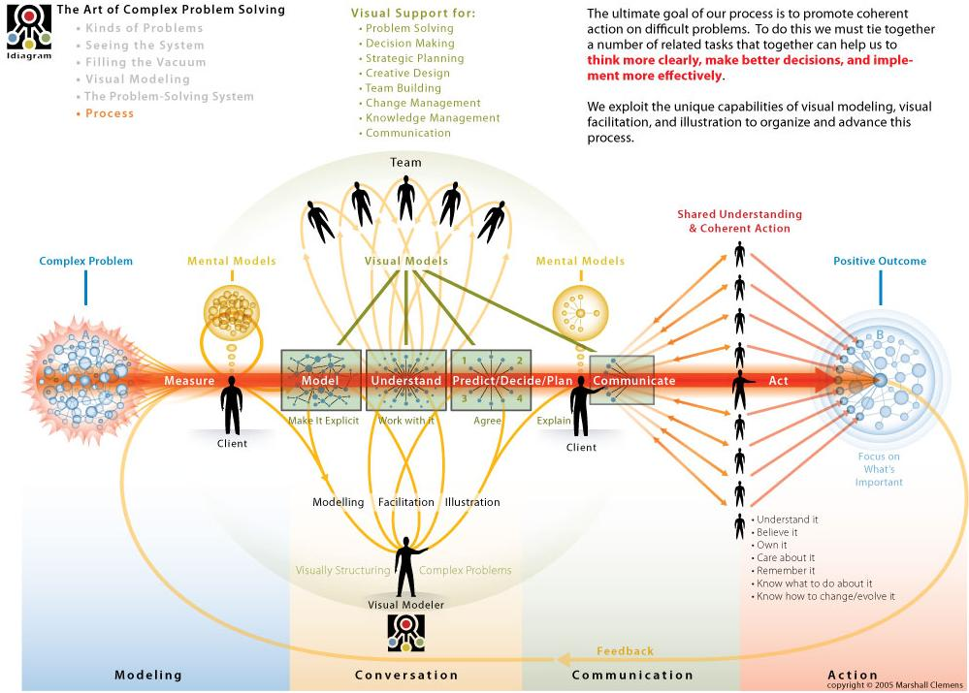
Complex Problem Solving

