Slide 1
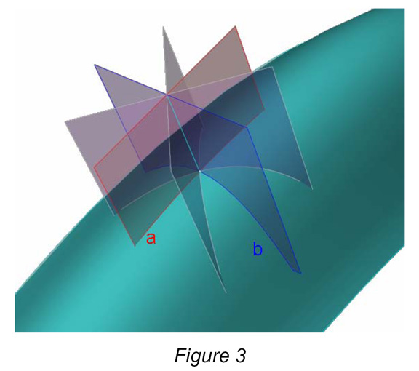
Surface curvatures

Slide 2
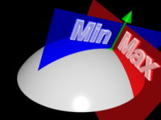
Surface curvatures

Slide 3
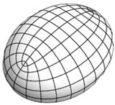
Lines of curvature

Slide 4
Surface curvatures
Gaussian = mincurvature x maxcurvature
Gaussian = 0: developable surface

Slide 5
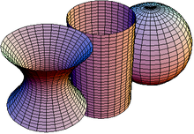
Gaussian curvature signs

Slide 6
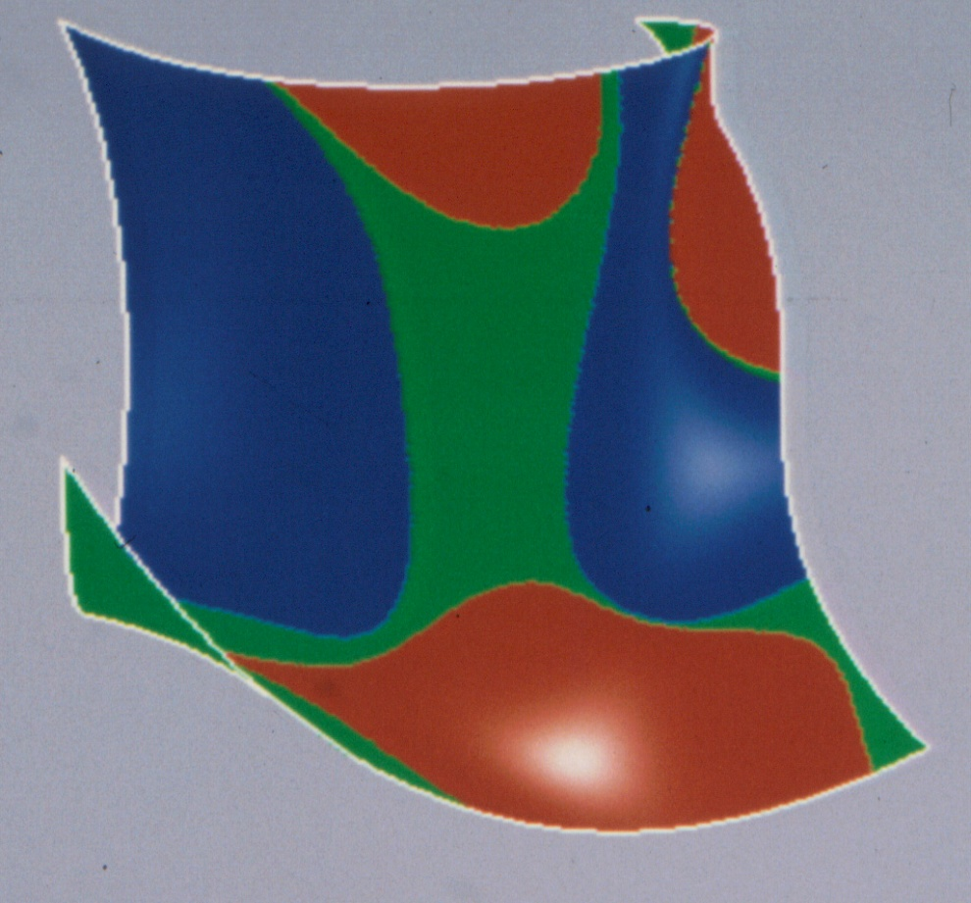
First Gaussian image

Slide 7
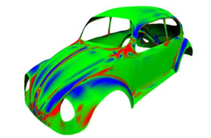
Gaussian application

Slide 8
Surface curvatures
Mean = mincurvature + maxcurvature
mean = 0: minimal surface

Slide 9
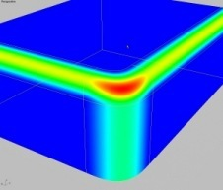
Mean curvature

Slide 10
Surface curvatures
maxcurvature

Slide 11
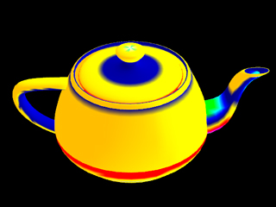
Gaussian curvature

Slide 12
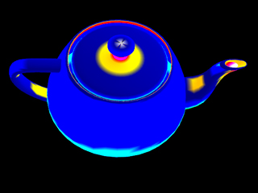
Mean curvature

Slide 13
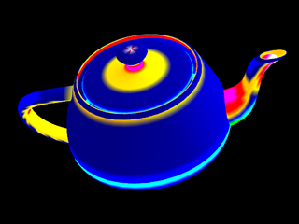
Max curvature

Slide 14
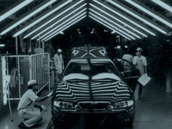
Reflection lines

Slide 15
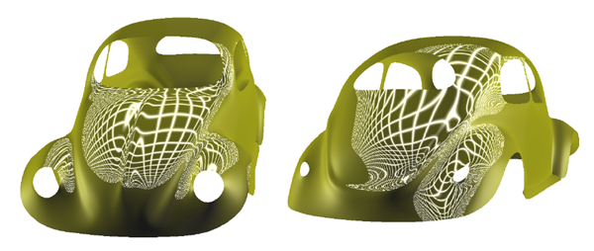
Reflection lines

